Slide 1
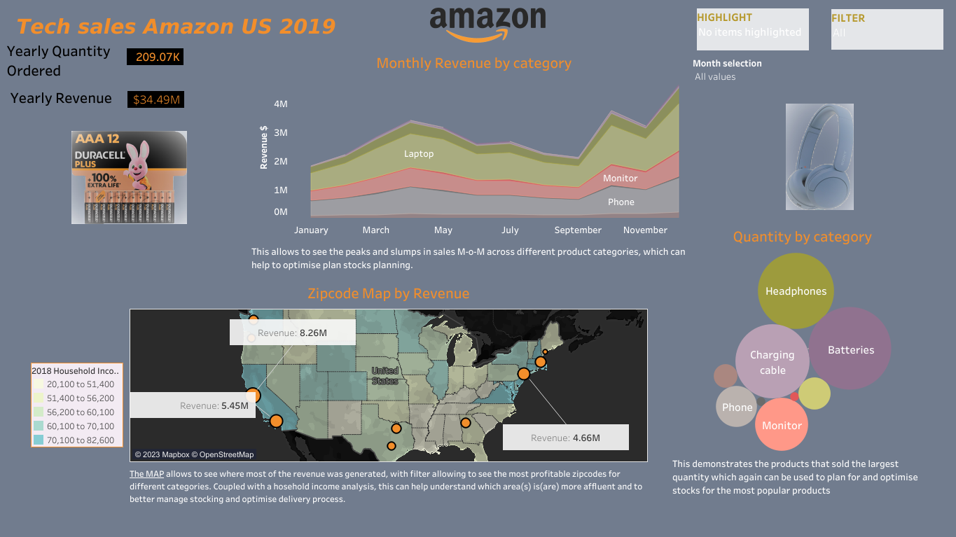
INTERACTIVE DASHBOARD

